Slide 1
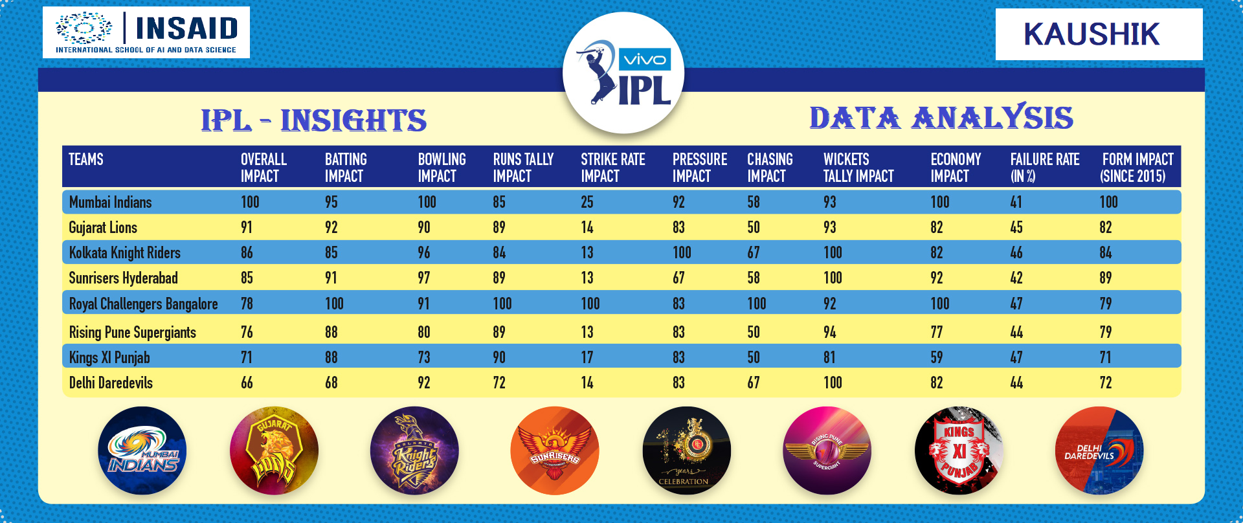

EDA ON IPL
By: Kaushik Rathod
Batch: Mar - 2020
Version IPL.1.0.0

Slide 2
REQUIREMENT
Find the best and worst team performance
Find the best player
DL Rules which team doing best
DL Rules - which decision should we take bat first or field first
By: Kaushik Rathod
Batch: Mar - 2020

Slide 3
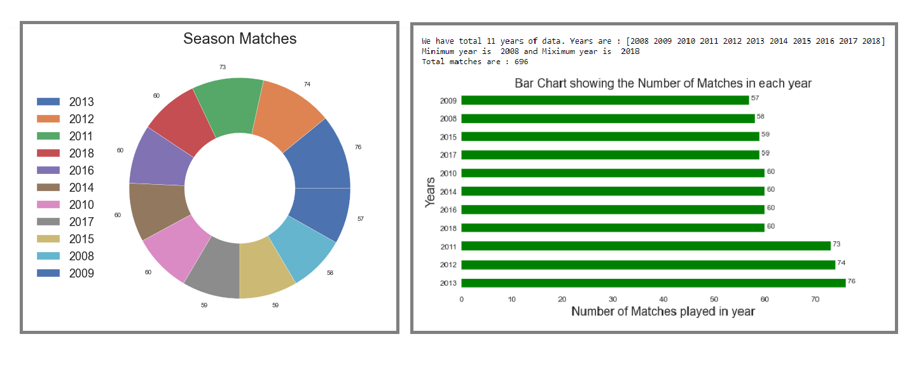
Data Summary 2008-2018
Highest No. of matches played in 2013 are 76
Lowest No. of matches played in 2009 are 57
Total Matches are 696
By: Kaushik Rathod
Batch: Mar - 2020

Slide 4
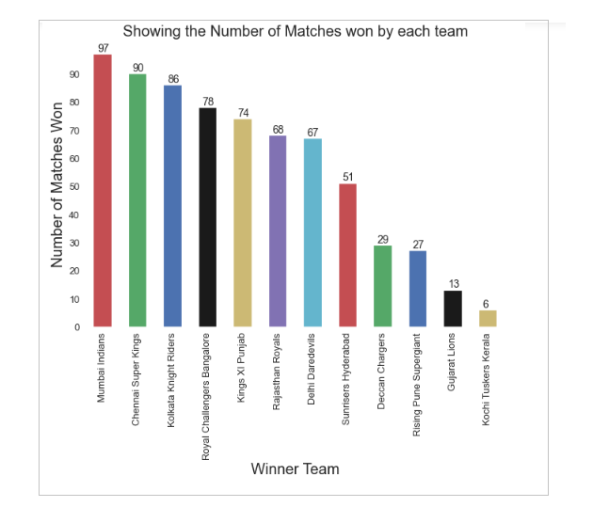
Team Summary – Total Matches All Seasons
Total 12 Teams
Mumbai Indian on the Top with – 97 wins
Kochi at the Bottom with – 6 wins
By: Kaushik Rathod
Batch: Mar - 2020

Slide 5
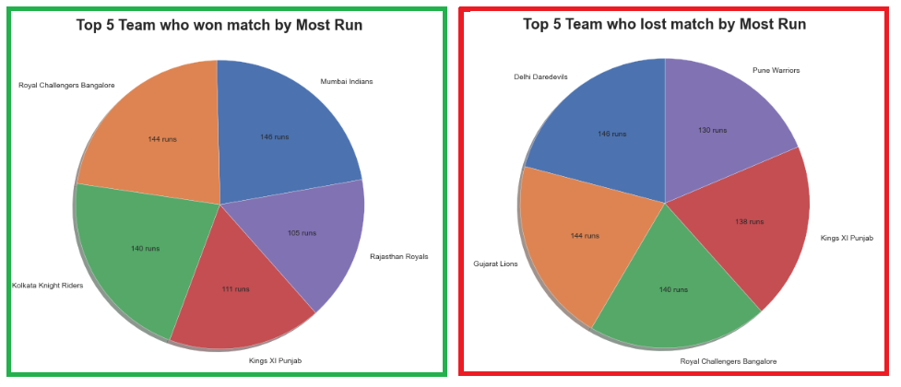
Team Top / Worst Performance
Showing Top 5 Team won and lost by Highest Margin
Mumbai Indians on Top of the table with 146 vs Delhi Daredevils
By: Kaushik Rathod
Batch: Mar - 2020

Slide 6
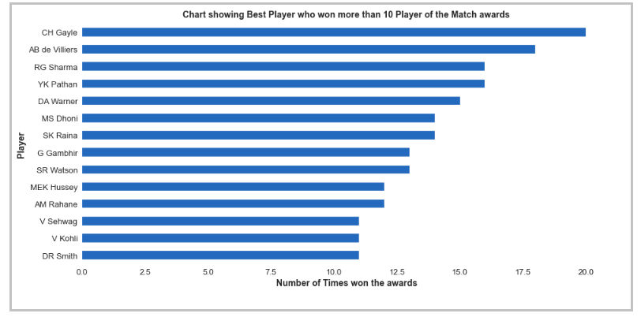
Player Performance
Gayle is the top of the Table
By: Kaushik Rathod
Batch: Mar - 2020

Slide 7
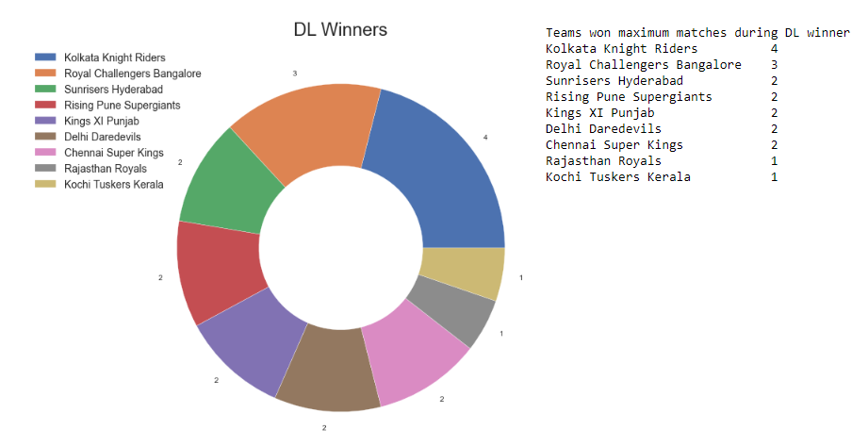
Team Performance on DL Rules
Showing Top 5 Team won and lost by Highest Margin
KKR is leading the tables in DL matches 4 Wins
Till now total 19 Matches gone for DL Rules
By: Kaushik Rathod
Batch: Mar - 2020

Slide 8
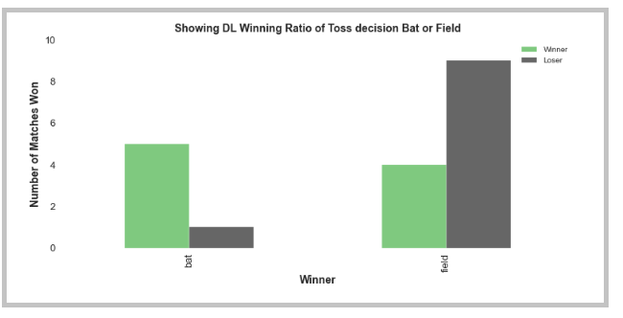
DL Rules Bat/Field First Decision
Team who has decided Bat First and DL applied chances of winning is high compare to field first
By: Kaushik Rathod
Batch: Mar - 2020

Slide 9
CONCLUSION
As I said this first phase of analysis
Mumbai Indians – Top performer
Cries Gayle - Best player
DL Rules - KKR has done well
Bat First decision has more chances to win the match in case of match gone for DL Rules
Not removed any data for analysis. For more accuracy we needs to do further analysis, needs to
finalize how many years of data we should take for deep analysis.
By: Kaushik Rathod
Batch: Mar -2020

Slide 10
THANK YOU!
By: Kaushik Rathod
Batch: Mar - 2020

